Slide 1


ECMAScript 6
& TypeScript
-- PART 1 --
copyright 2016 Trainologic LTD

Slide 2

ECMAScript 6 & TypeScript
Intro
Intro
Block Scoped Variables
Arrow Functions
Rest Parameters
Template Strings
Default Parameters
Computed Property Names
Destructuring Assignment
for...of
2
copyright 2016 Trainologic LTD

Slide 3

ECMAScript 6 & TypeScript
About This Part
Focuses on ES6 specific features
That is: features that exist in ECMAScript 2015
These features provide extended capabilities
When the TS compiler target option is set to “es5” (*), TS code is transpiled into standard ES5 JS * (this is what we want until ES6 is fully supported)
3
3
copyright 2016 Trainologic LTD

Slide 4
ECMAScript 6 & TypeScript
ECMA Who?
ECMAScript (or ES)
A trademarked scripting language specification
Owned by ECMA International
ECMA International
European Computer Manufacturers Association
A private, non-profit international standards organization
Develop standards & reports to facilitate and standardize the use of information communication technology and consumer electronics
Members: Adobe, HP, Google, IBM, PayPal, MS, Intel, Hitachi, …
Spec implementations include:
JavaScript
ActionScript (Macromedia)
JScript (Microsoft)
3
4
copyright 2016 Trainologic LTD

Slide 5
ECMAScript 6 & TypeScript
ECMAScript – Bit of History
1995: Mocha (JavaScript’s original name) developed at Netscape
Developed in only 10 days. Interestingly, they soon after also released a server-side scripting version
1996: JS taken to ECMA for standartization
1997: ECMAScript standard edition 1 released
1998: edition 2, ISO alignments (no new features)
1999: edition 3, introducing regex, better string handling, new control statements, try/catch ex. handling and more.
In-between: Edition 4 dropped due to political differences
2009: edition 5, introducing “strict mode”, JSON support, object properties reflection and more.
2011: edition 5.1, ISO-3 alignments (no new features)
2015: edition 6, a.k.a. ES6 / ECMAScript 2015 / ES6 Harmony
June 2016: edition 7, with only two features: exponentiation operator (**) and Array.prototype.includes
3
5
copyright 2016 Trainologic LTD

Slide 6
ECMAScript 6 & TypeScript
ES7 – Why So Small?
ES7 / ECMAScript 2016 is so small due to the new release process, which is actually good
New features are only included after they are completely ready and after there were at least two implementations that were sufficiently field-tested.
Releases will now happen much more frequently (once a year) and will be more incremental
3
6
copyright 2016 Trainologic LTD

Slide 7
ECMAScript 6 & TypeScript
Atwood’s Law
“Any application that can be written in JavaScript will eventually be written in JavaScript”
3
7
copyright 2016 Trainologic LTD

Slide 8

ECMAScript 6 & TypeScript
Note about Sloppy Mode
In this presentation you might see mentions of the term “Sloppy Mode”
This is a common (but unofficial) term referring to the normal, non-strict mode of JavaScript
3
8
copyright 2016 Trainologic LTD

Slide 9
ECMAScript 6 & TypeScript
Intro
Classes & Packages.
Arrow Functions
Rest Parameters
Template Strings
Default Parameters
Computed Property Names
Destructuring Assignment
for...of
Block Scoped Variables
9
copyright 2016 Trainologic LTD

Slide 10
ECMAScript 6 & TypeScript
var’s Function Scope
One of the common complaints has been JavaScript’s lack of block scope
Unlike other popular languages (C/Java/…), blocks ({...}) in JavaScript (pre-ES6) do not have a scope
Variables in JavaScript are scoped to their nearest parent function, or globally if there is no function present
10
copyright 2016 Trainologic LTD

Slide 11

ECMAScript 6 & TypeScript
Why No Block Scope?
JavaScript was created in 10 days in May 1995 by Brendan Eich, then working at Netscape
When asked why JavaScript does not have block scopes, Brendan replied:
There wasn’t enough time
11
copyright 2016 Trainologic LTD

Slide 12
ECMAScript 6 & TypeScript
var Challenges
Scoping is confusing for developers coming from other languages
Local vs. Global confusion, accidental shadowing
Confusing workaround patterns: IIFE
Misconceptions about hoisting
function blocky() { if (!hoisty) { var hoisty = “gotcha"; } alert(hoisty); // alerts “gotcha" instead of reference error } blocky();
12
copyright 2016 Trainologic LTD

Slide 13
ECMAScript 6 & TypeScript
The let Statement
Using “let” instead (ECMAScript 6) is more intuitive
let Syntax (similar to “var”): let var1 [= value1] [, var2 [= value2]] [, ..., varN [= valueN]];
function blocky() { if (!hoisty) { let hoisty = “gotcha"; } alert(hoisty); // reference error: hoisty is not defined } blocky();
3
13
copyright 2016 Trainologic LTD

Slide 14
ECMAScript 6 & TypeScript
let Semantics
The new ES6 keyword let allows scoping variables at the block level (the nearest curly brackets)
limited in scope to the block, statement, or expression on which it is used
var fruit = “guava”;
if (true) {
let fruit = “mango”;
console.log(fruit); // mango
}
console.log(fruit); // guava
var listItems = document.querySelectorAll(‘li’);
for (let i = 0; i < listItems.length; i++) {
let element = listItems[i];
element.addEventListenet(‘click’, function() {
alert(‘Clicked item number ‘ + i);
});
}
3
14
copyright 2016 Trainologic LTD

Slide 15
ECMAScript 6 & TypeScript
let Limitations
Cannot be re-declared in same block scope
SyntaxError: Identifier … has already been declared
Also applies in switch-case blocks
Also applies to using var x after let x statement
Can’t shadow function argument names
let variables cannot be referenced before their declaration
The variable is hoisted to top of block
however it is in “temporal dead zone” and cannot be accessed
Will result in ReferenceError
3
15
copyright 2016 Trainologic LTD

Slide 16
ECMAScript 6 & TypeScript
var vs. let
var x = ‘global’;
let y = ‘not global’;
console.log(this.x); // “global”
console.log(this.y); // undefined
3
16
copyright 2016 Trainologic LTD

Slide 17
ECMAScript 6 & TypeScript
Block Scopes & TS - let
TS transpiles let to var declarations
Renames variable name if it already exists in surrounding scope
// fooya.ts
var foo = ‘fooya!’;
If (true) {
let foo = ‘nununu!’;
}
console.log(foo); // fooya
// fooya.js
var foo = ‘fooya!’;
If (true) {
var foo_1 = ‘nununu!’;
}
console.log(foo); // fooya
3
17
copyright 2016 Trainologic LTD

Slide 18
ECMAScript 6 & TypeScript
Block Scopes & TS – let cont.
TS transpiles let to var in for loops too
For simple loops, TS ends it there
// loopy.ts
for (let i = 0; I < 5; i++) {
console.log(i);
}
// loopy.js
for (var i = 0; I < 5; i++) {
console.log(i);
}
18
copyright 2016 Trainologic LTD

Slide 19
ECMAScript 6 & TypeScript
Block Scopes & TS – let cont.
When closures in for loops are detected however, TS will extract the call out to a separate function
// closure.ts
var funcs = [];
for (let i = 0; I < 5; i++) {
funcs.push(function() {
console.log(i);
});
}
// closure.js
var funcs = [];
var _loop_1 = function(i) {
funcs.push(function() {
console.log(i);
});
};
for (var i = 0; I < 5; i++) {
_loop_1(i);
}
19
copyright 2016 Trainologic LTD

Slide 20
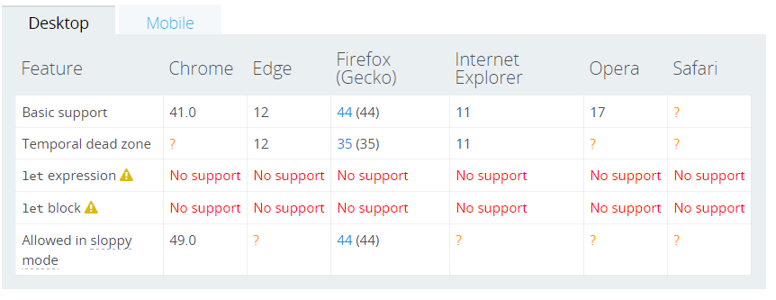
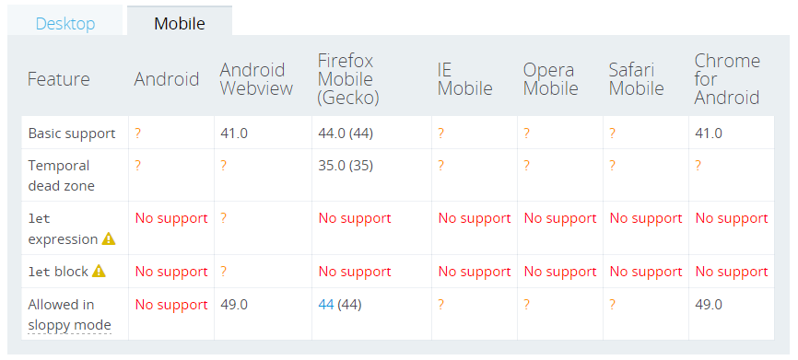
ECMAScript 6 & TypeScript
Browser Compatibility - let
20
copyright 2016 Trainologic LTD

Slide 21
ECMAScript 6 & TypeScript
const
Syntax: const name1 = value1 [, name2 = value2 [, ... [, nameN = valueN]]];
Creates a read-only reference to a value
Doesn’t mean the value is immutable; only the variable identifier can’t be reassigned
Constant declarations must be initialized
Constants are block-scoped, similar to let variables
Constants values cannot be re-assigned nor re-declared
All “temporal dead zone” considerations applying to “let” apply here too
21
copyright 2016 Trainologic LTD

Slide 22
ECMAScript 6 & TypeScript
const – Examples
const PI = 3.141592;
const API_KEY = ‘super*secret*123’;
const HEROES = [];
HEROES.push(‘Jon Snow’); // okay
HEROES.push(‘Tyrian Lannister’); // okay
HEROES = [‘Ramsay Bolton’, ‘Walder Frey’]; // error
22
copyright 2016 Trainologic LTD

Slide 23
ECMAScript 6 & TypeScript
Block Scopes & TS - const
TS simply transpiles const to var declarations
// constantin.ts
const c = 84;
function funk() {
const c = 42;
}
// constantin.js
var c = 84;
function funk{
var c = 42;
}
23
copyright 2016 Trainologic LTD

Slide 24
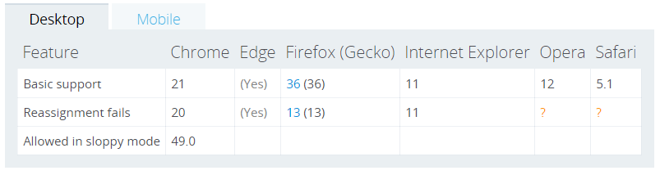
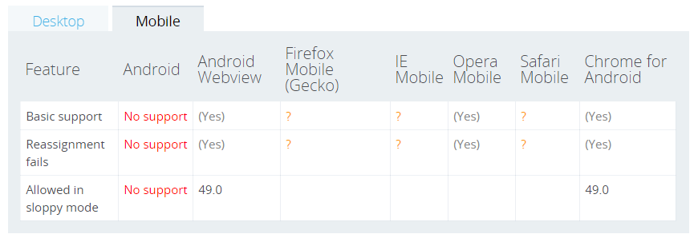
ECMAScript 6 & TypeScript
Browser Compatibility - const
24
copyright 2016 Trainologic LTD

Slide 25
ECMAScript 6 & TypeScript
When Do We Use Which?
One recommendation:
Use const by default
Use let if you have to rebind a variable
Use var to signal untouched legacy code
But other opinions exist:
Use var to signal variables used throughout the function (i.e. function scope)
25
copyright 2016 Trainologic LTD

Slide 26
ECMAScript 6 & TypeScript
Intro
Block Scoped Variables
Arrow Functions
Rest Parameters
Template Strings
Default Parameters
Computed Property Names
Destructuring Assignment
for...of
Arrow Functions
26
copyright 2016 Trainologic LTD

Slide 27
ECMAScript 6 & TypeScript
Arrow Functions
A.k.a. “Fat Arrow” (because -> is a thin arrow and => is a fat arrow)
A.k.a. “Lambda Function” (because of other languages)
Promotes the functional programming paradigm in JS
Addresses a JS pain-point of losing the meaning of this
Motivation:
No need to keep typing function
Lexically captures this from the surrounding context
Lexically captures arguments of a function
27
copyright 2016 Trainologic LTD

Slide 28
ECMAScript 6 & TypeScript
Basic Syntax
(param1, param2, …, paramN) => { statements }
(param1, param2, …, paramN) => expression
// equivalent to: => { return expression; }
// Parentheses are optional with a single parameter:
(singleParam) => { statements }
singleParam => { statements }
// A function with no parameters requires parentheses:
() => { statements }
28
copyright 2016 Trainologic LTD

Slide 29
ECMAScript 6 & TypeScript
Examples
var f_1 = (x) => x + 1; // increment by 1
let f_2 = x => 2 * x; // muiply by 2
// zero arguments requires using parentheses
const f_3 = () => console.log(‘look ma, no arguments’);
// as anonymous timer callback
setTimeout(() => { console.log('well, it is about time'); }, 1000);
29
copyright 2016 Trainologic LTD

Slide 30
ECMAScript 6 & TypeScript
Advanced Syntax
// Parenthesize the body to return an object literal expression
params => ({foo: bar})
// Rest parameters and default parameter values
(param1, param2, ...rest) => { statements }
(param1 = defaultValue1, param2, …, paramN = defaultValueN) => { statements }
// Destructuring within the parameter list
var f = ([a, b] = [1, 2], {x: c} = {x: a + b}) => a + b + c;
f(); // 6
30
copyright 2016 Trainologic LTD

Slide 31
ECMAScript 6 & TypeScript
The Lexical this
Until arrow functions, every new function defined its own this value:
Constructor: new object
Strict Mode: undefined
“Object Method”: the context object
We had to use a capture variable to keep hold of this
31
copyright 2016 Trainologic LTD

Slide 32

ECMAScript 6 & TypeScript
Using a Capture Variable
That can become very annoying, especially with OOP
// annoying.js
function QuoteMaster() {
var self = this;
this.quote = ‘if only we had arrow functions’;
this.sayIt = function() {
console.log(self.quote);
};
setTimeout(this.sayIt, 1000);
}
32
copyright 2016 Trainologic LTD

Slide 33

ECMAScript 6 & TypeScript
Using an Arrow Function
The this reference is captured from outside the function body
// relaxing.js
function QuoteMaster() {
this.quote = ‘luckily we have arrow functions’;
this.sayIt = () => console.log(this.quote);
setTimeout(this.sayIt, 1000);
}
33
copyright 2016 Trainologic LTD

Slide 34
ECMAScript 6 & TypeScript
Arrow Functions & TS
Behind the scenes TS generates a capture variable
// relaxing.ts
function QuoteMaster() {
this.quote = ‘fat arrow rulez’;
this.sayIt = () =>
console.log(this.quote);
setTimeout(this.sayIt, 1000);
}
// relaxing.js
function QuoteMaster() {
var _this = this; // capture variable
this.quote = ‘fat arrow rulez';
this.sayIt = function () {
return console.log(_this.quote);
};
setTimeout(this.sayIt, 1000);
}
34
copyright 2016 Trainologic LTD

Slide 35
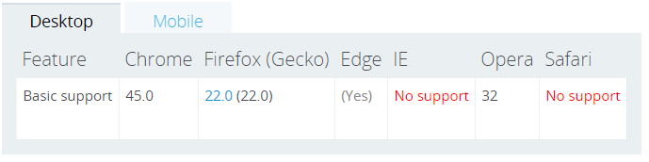
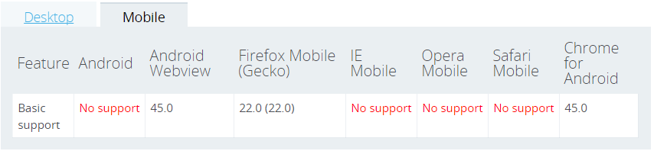
ECMAScript 6 & TypeScript
Browser Compatibility – Arrow Function
35
copyright 2016 Trainologic LTD

Slide 36
ECMAScript 6 & TypeScript
Intro
Block Scoped Variables
Arrow Functions
String Templates
Template Strings
Default Parameters
Computed Property Names
Destructuring Assignment
for...of
Rest Parameters
36
copyright 2016 Trainologic LTD

Slide 37
ECMAScript 6 & TypeScript
Rest Parameters
Convenient way to accept multiple parameters as array
Denoted by ...restArgsName as the last argument
The ellipsis notation (…) is a new spread operator
Reduce boilerplate code induced by the arguments
Can be used in any function (plain function / fat arrow)
Syntax: function(a, b, ...allTheRest) { // … }
Spread operator
37
copyright 2016 Trainologic LTD

Slide 38
ECMAScript 6 & TypeScript
Rest Parameters
Differences between rest parameters and arguments object:
 | Rest Parameters | arguments Object
Parameters received | Only those not given separate name | All arguments passed to the function
Is Array? | A real array (supports sort, map, forEach, pop) | Not a real array
Special Properties | None | Has specific functionality, e.g. callee
38
copyright 2016 Trainologic LTD

Slide 39
ECMAScript 6 & TypeScript
Example – Rest Parameters
function getTheOthers(first, second, ...allOthers) { console.log(allOthers); }
// [] empty array since first two args are named (“first”, “second”)
getTheOthers('Cersei Lannister', 'Daenerys Targaryen');
// ['Khal Drogo', 'Roose Bolton', 'Robert Baratheon'] getTheOthers('Cersei Lannister', 'Daenerys Targaryen',
'Khal Drogo', 'Roose Bolton', 'Robert Baratheon');
39
copyright 2016 Trainologic LTD

Slide 40
ECMAScript 6 & TypeScript
Rest Parameters & TS
// reverts to using the arguments object
function getTheOthers(first, second) { var allOthers = []; for (var _i = 2; _i < arguments.length; _i++) { allOthers[_i - 2] = arguments[_i]; } console.log(allOthers); }
// [] empty array since first two args are named (“first”, “second”) getTheOthers('Cersei Lannister', 'Daenerys Targaryen');
// ['Khal Drogo', 'Roose Bolton', 'Robert Baratheon'] getTheOthers('Cersei Lannister', 'Daenerys Targaryen', 'Khal Drogo', 'Roose Bolton', 'Robert Baratheon');
40
copyright 2016 Trainologic LTD

Slide 41
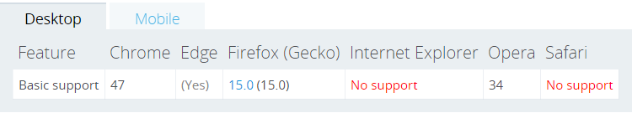
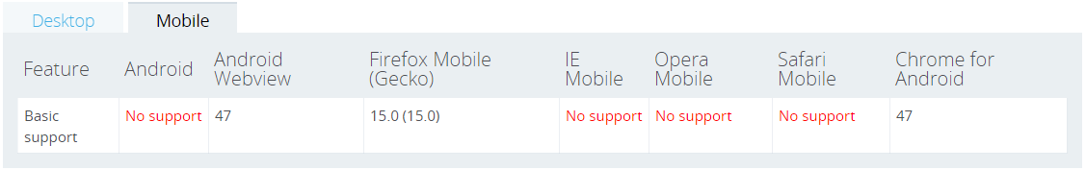
ECMAScript 6 & TypeScript
Browser Compatibility - Rest Parameters
41
copyright 2016 Trainologic LTD

Slide 42
ECMAScript 6 & TypeScript
Intro
Block Scoped Variables
Arrow Functions
Rest Parameters
Rest Parameters
Default Parameters
Computed Property Names
Destructuring Assignment
for...of
Template Strings
42
copyright 2016 Trainologic LTD

Slide 43
ECMAScript 6 & TypeScript
Template Strings (also: String Literals)
Syntactically these are strings that use backticks `
Motivation:
Multiline strings
String interpolation (i.e. parameterized)
Tagged templates
This is a backtick right here
43
copyright 2016 Trainologic LTD

Slide 44
ECMAScript 6 & TypeScript
Template Strings – cont.
Mutiline Strings
Allows us to easily create a string spanning multiple lines
String Interpolation
Allow us to create string templates with placeholders
Placeholder expressions are evaluated into the resulting string
Tagged Templates
Allow us to place a function (called a tag) before the template string
The tag function gets the opportunity to pre-process the template string literals and placeholder expressions
Can be used for example for escaping the string
44
copyright 2016 Trainologic LTD

Slide 45
ECMAScript 6 & TypeScript
Template Strings – Syntax
`string text` // simple string literal
`string text line 1
string text line 2` // multiline string literal
`string text ${expression} string text` // interpolation literal
tag `string text ${expression} string text` // tagged template
45
copyright 2016 Trainologic LTD

Slide 46
ECMAScript 6 & TypeScript
Examples – Multiline & Interpolation
// multiline
var debugLyrics = `Catch, catch, catch a bug. Put it in a jar. Sometimes they fly, sometimes they die, but most get squashed on your car.`;
// interpolation
let htmlString = `<div class=“song”>${debugLyrics}</div>`;
// hack, we can practically interpolate any expression
const theAnswer = `2 times 21 make ${2 * 21}`;
46
copyright 2016 Trainologic LTD

Slide 47
ECMAScript 6 & TypeScript
Example – Tagged Template
var animal = "dog";
var result = myTagFunc `${animal}s are the best!`;
function myTagFunc(literals, ...values) { // a sample tag function
let result = "";
for (let i = 0; i < values.length; i++) { // interleave the literals with the values
result += literals[i];
result += values[i] === animal ? 'literal string' : values[i]; // replace dawg
}
result += literals[literals.length - 1]; // add the last literal
return result;
}
console.log(result); // literal strings are the best!
47
copyright 2016 Trainologic LTD

Slide 48
ECMAScript 6 & TypeScript
Template Strings & TS
TS transpiles multiline strings → escaped strings
TS transpiles string interpolations → string concatenations
var debugLyrics = "Catch, catch, catch a bug.\u00A0\v\nPut it in a jar.\u00A0\v\nSometimes they fly, \nsometimes they die,\u00A0\n\vbut most get squashed on your car.";
var theAnswer = "2 times 21 make " + 2 * 21;
48
copyright 2016 Trainologic LTD

Slide 49
ECMAScript 6 & TypeScript
Template Strings & TS
TS transpiles tagged templates → function calls
var animal = "dog"; var result = (_a = ["", "s are the best!"], _a.raw = ["", "s are the best!"], myTagFunc(_a, animal));
function myTagFunc(literals) { // a sample tag function var values = []; for (var _i = 1; _i < arguments.length; _i++) { values[_i - 1] = arguments[_i]; } var result = ""; for (var i = 0; i < values.length; i++) { // interleave the literals with the values result += literals[i]; result += values[i] === animal ? 'literal string' : values[i]; // replace dawg } result += literals[literals.length - 1]; // add the last literal return result; } console.log(result); // literal strings are the best! var _a;
49
copyright 2016 Trainologic LTD

Slide 50
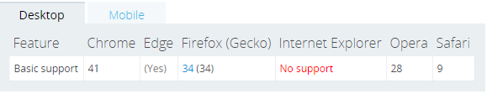

ECMAScript 6 & TypeScript
Browser Compatibility – Template Strings
50
copyright 2016 Trainologic LTD

Slide 51
ECMAScript 6 & TypeScript
Intro
Block Scoped Variables
Arrow Functions
Rest Parameters
Template Strings
Default Parameters
Computed Property Names
Destructuring Assignment
for...of
Default Parameters
51
copyright 2016 Trainologic LTD

Slide 52
ECMAScript 6 & TypeScript
Default Parameters
In JavaScript, parameters of functions default to undefined
It is useful in some situations to set different defaults
Default function parameters allow formal parameters to be initialized with default values if no value or undefined is passed
Syntax: function [name]([param1[ = defaultValue1 ] [, ..., paramN[ = defaultValueN ]]]) { statements }
52
copyright 2016 Trainologic LTD

Slide 53
ECMAScript 6 & TypeScript
Default Parameters – cont.
Replaces the common strategy of testing values in function body: function multiply(a, b) { var b = b !== undefined ? b : 1; // yuck! …
Instead we can more elegantly write: function multiply(a, b = 1) {
53
copyright 2016 Trainologic LTD

Slide 54
ECMAScript 6 & TypeScript
Default Parameters – Example
function sendRaven(to, body, subject = 'New Raven Mail') { console.log(`Sending mail with subject "${subject}"`); } var recipients = ['Lord Commander<lord.commander@castleblack.org', 'Maester<maester@castleblack.org'];
// Sending mail with subject "New Raven Mail" sendRaven(recipients, "The winter is coming");
// Sending mail with subject "New Raven Mail" sendRaven(recipients, "The winter is coming", undefined);
// Sending mail with subject “Winter Sale!" sendRaven(recipients, "The winter is coming", “Winter Sale!");
54
copyright 2016 Trainologic LTD

Slide 55
ECMAScript 6 & TypeScript
Default Parameters – cont.
Default parameters are available to consequent default parameters
function runWeirdCalc(a, b, c = 42, d = c / 2) { console.log(`Calculation yields: ${a * b + c + d} (${a} * ${b} + ${c} + ${d})`;
}
runWeirdCalc(); // Calculation yields: NaN (undefined * undefined + 42 + 21) runWeirdCalc(1); // Calculation yields: NaN (1 * undefined + 42 + 21)
runWeirdCalc(1, 2); // Calculation yields: 65 (1 * 2 + 42 + 21)
runWeirdCalc(1, 2, 3); // Calculation yields: 6.5 (1 * 2 + 3 + 1.5)
runWeirdCalc(1, 2, 3, 4); // Calculation yields: 9 (1 * 2 + 3 + 4)
55
copyright 2016 Trainologic LTD

Slide 56
ECMAScript 6 & TypeScript
Default Parameters – cont.
Default parameters can even accept other default values, such as function calls, this and the arguments object
function getD() { return "You got Dee!" } function checkThisOut(a, b = 5, c = b, d = getD(), e = this, f = arguments, g = this.whatsThis) { return [a,b,c,d,e,f,g]; }
// ["Whoa", 5, 5, "You got Dee!", Window, Arguments[1], undefined]
// (Note: Arguments only contains “Whoa”) console.log(checkThisOut("Whoa"));
56
copyright 2016 Trainologic LTD

Slide 57
ECMAScript 6 & TypeScript
Default Parameters – cont.
As opposed to other languages (C# et al.), defaults can be provided to any parameter(s), not necessarily consecutive or in any particular order
function func (a = 42, b, c = a, d, e = “Cool”) { return [a,b,c,d,e]; }
console.log(func(undefined, 15, “Yeah”)); // [42, 15, "Yeah", undefined, "Cool"]
57
copyright 2016 Trainologic LTD

Slide 58
ECMAScript 6 & TypeScript
Default Parameters – cont.
Destructured parameter with default value assignment
function func([x, y] = [1, 2], {z: z} = {z: 3}) {
return x + y + z;
}
func(); // 6
58
copyright 2016 Trainologic LTD

Slide 59
ECMAScript 6 & TypeScript
Default Parameters & TS
TypeScript transpiles to code which sets defaults in case the argument value is undefined
(it uses the void operator to obtain the undefined primitive)
function sendRaven(to, body, subject) { if (subject === void 0) { subject = 'New Raven Mail'; } console.log("Sending mail with subject \"" + subject + "\""); }
function runWeirdCalc(a, b, c, d) { if (c === void 0) { c = 42; } if (d === void 0) { d = c / 2; } console.log("Weird calculation yields: " + (a * b + c + d) + " (" + a + " * " + b + " + " + c + " + " + d + ")");
59
copyright 2016 Trainologic LTD

Slide 60
ECMAScript 6 & TypeScript
Default Parameters & TS – cont.
function checkThisOut(a, b, c, d, e, f, g) { if (b === void 0) { b = 5; } if (c === void 0) { c = b; } if (d === void 0) { d = getD(); } if (e === void 0) { e = this; } if (f === void 0) { f = arguments; } if (g === void 0) { g = this.whatsThis; } return [a, b, c, d, e, f, g]; }
60
copyright 2016 Trainologic LTD

Slide 61
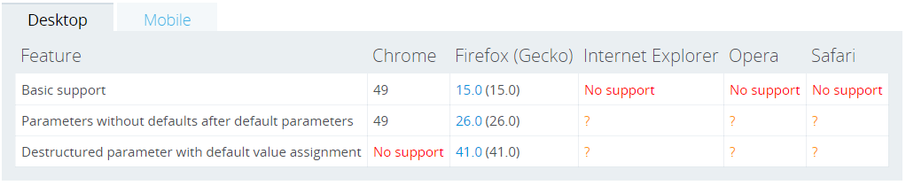
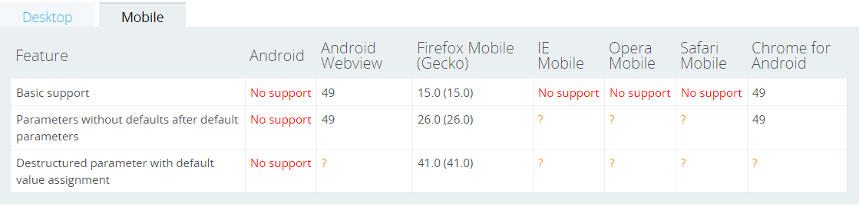
ECMAScript 6 & TypeScript
Browser Compatibility – Default Parameters
61
copyright 2016 Trainologic LTD

Slide 62
ECMAScript 6 & TypeScript
Intro
Block Scoped Variables
Arrow Functions
Rest Parameters
Template Strings
Default Parameters
Computed Properties
Destructuring Assignment
for...of
Computed Property Names
62
copyright 2016 Trainologic LTD

Slide 63
ECMAScript 6 & TypeScript
Computed Property Names
ES6 introduces the ability to define object property names based on computed keys
Syntax: obj[{computed_expression}] = {value} // usage in object literals obj = { [{computed_expression}]: {value} };
63
copyright 2016 Trainologic LTD

Slide 64
ECMAScript 6 & TypeScript
Examples
var x = 100, y = "abc";
function getPropName() { return ++x; }
//
// object literal
// var literal = { ["prop_" + getPropName()]: "Example 1", ["prop_" + y]: "Example 2" }; console.log(literal); // {prop_101: "Example 1", prop_abc: "Example 2"}
//
// create a new computed property name (member) on the function object
//
getPropName["static_" + getPropName()] = y;
console.log(getPropName.static_102); // abc
64
copyright 2016 Trainologic LTD

Slide 65
ECMAScript 6 & TypeScript
Computed Property Names & TS
Computed literal property names are transpiled into separate expressions, one per property
var x = 100; var y = "abc"; function getPropName() { return ++x; } var literal = (_a = {}, // new empty object is constructed _a["prop_" + getPropName()] = "Example 1", // computer property 1 _a["prop_" + y] = "Example 2", // computer property 2 _a // final statement returns the object ); console.log(literal); getPropName["static_" + getPropName()] = y; // no special handling for this case console.log(getPropName.static_102); var _a; // object reference variable is declared as _a
65
copyright 2016 Trainologic LTD

Slide 66
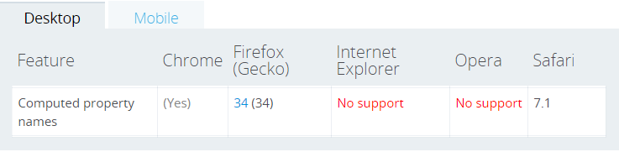
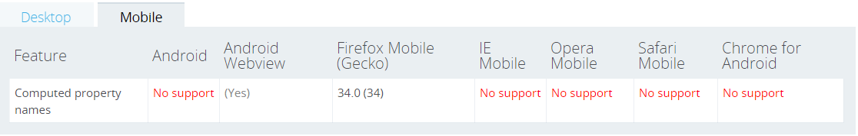
ECMAScript 6 & TypeScript
Browser Compatibility – Dynamic Property Names
66
copyright 2016 Trainologic LTD

Slide 67
ECMAScript 6 & TypeScript
Intro
Block Scoped Variables
Arrow Functions
Rest Parameters
Template Strings
Default Parameters
Computed Properties
Destructuring Assignment
for...of
Destructuring Assignment
67
copyright 2016 Trainologic LTD

Slide 68
ECMAScript 6 & TypeScript
Destructuring Assignment
De-structuring literally means breaking up a structure
Expressions that extract array/object data → distinct variables
Two destructuring types are supported: Array and Object
Syntax: // array destructuring assignment [a, b] = [1, 2]; // a=1, b=2 [a, b, ...rest] = [1, 2, 3, 4, 5] // a=1, b=2, rest= [3,4,5] // object destructuring assignment ({a, b} = {a:1, b:2}) // a=1, b=2 ({a, b, ...rest} = {a:1, b:2, c:3, d:4}); // a=1, b=2, rest=[3,4]
68
copyright 2016 Trainologic LTD

Slide 69
ECMAScript 6 & TypeScript
Examples – Object Destructuring
var lastEpisode = { season: 6, episode: 10, title: "The Winds of Winter", aired: "2016-06-26" };
// dstructuring assignment of all properties
// var {season, episode, title, aired} = lastEpisode;
console.log(season, episode, title, aired); // 6, 10, "The Winds of Winter", "2016-06-26“
// dstructuring assignment of only few properties
//
var {title, aired} = lastEpisode;
console.log(title, aired); // "The Winds of Winter", "2016-06-26“
// assign extracted variable to new variable name
//
var {title, "aired": releaseDate} = lastEpisode; console.log(releaseDate); // "2016-06-26“
69
copyright 2016 Trainologic LTD

Slide 70
ECMAScript 6 & TypeScript
Examples – Deep Object Destructuring
// create an object with nested properties
var lastEpisodeWithInfo = {
season: 6, episode: 10, title: "The Winds of Winter", aired: "2016-06-26", extraInfo: {
chapter: 60, director: "Miguel Sapochnik", author: "David Benioff & D.B. Weiss“
}
};
// note the deep object destructuring var {extraInfo: {chapter, "director": directedBy}} = lastEpisodeWithInfo;
console.log("directed by " + directedBy); // directed by Miguel Sapochnik
70
copyright 2016 Trainologic LTD

Slide 71
ECMAScript 6 & TypeScript
Examples – Array Destructuring
var x = 1, y = 2, z = “Zed”; var a, b, others;
// array destructuring + variable renaming [a, b] = [x, y];
console.log(a, b); // 1,2
// swap variables
[y, x] = [x, y]; console.log(x, y); // 2,1
// destructuring with rest parameters
[x, ...others] = [x, y, z]; console.log(others); // [1, "Zed"]
71
copyright 2016 Trainologic LTD

Slide 72
ECMAScript 6 & TypeScript
Examples – Array Destructuring – cont.
We can ignore any index by using a sparse assignments array
Ignore particular values by leaving a location empty (i.e. , ,) in the left hand side of the assignment
var v1 = "take me", v2 = "ignore me", v3 = "take me too",
v4 = "I’m in", v5 = "last but not least";
var one, three, others; [one, , three, ...others] = [v1, v2, v3, v4, v5]; // ^-- note the empty location here. v2 will be ignored
console.log(one, three, others);
// “take me”, “take me too”, ["I’m in", "last but not least"]
72
copyright 2016 Trainologic LTD

Slide 73
ECMAScript 6 & TypeScript
Object Destructuring & TS
TS transpiles into simple value extraction and variable assignment
var lastEpisodeWithInfo = {
season: 6, episode: 10, title: "The Winds of Winter", aired: "2016-06-26", extraInfo: {
chapter: 60, director: "Miguel Sapochnik", author: "David Benioff & D. B. Weiss"
}
};
var _a = lastEpisodeWithInfo.extraInfo, // temporary handle
chapter = _a.chapter, // simple property destructure
directedBy = _a["director"]; // destructure + rename
console.log("directed by " + directedBy);
73
copyright 2016 Trainologic LTD

Slide 74
ECMAScript 6 & TypeScript
Array Destructuring & TS
var v1 = "take me", v2 = "ignore me", v3 = "take me too", v4 = "I’m in", v5 = "last but not least";
var one, three, others;
// temporary array is used from which destructured variables are cherry picked
_a = [v1, v2, v3, v4, v5], one = _a[0], three = _a[2], others = _a.slice(3);
// note the slice from index 3 to get the …rest parameters ---------------------^
console.log(one, three, others);
var _a;
74
copyright 2016 Trainologic LTD

Slide 75
ECMAScript 6 & TypeScript
Destructuring Assignment & TS
Computed literal property names are transpiled into separate expressions, one per property
var x = 100; var y = "abc"; function getPropName() { return ++x; } var literal = (_a = {}, // new empty object is constructed _a["prop_" + getPropName()] = "Example 1", // computer property 1 _a["prop_" + y] = "Example 2", // computer property 2 _a // final statement returns the object ); console.log(literal); getPropName["static_" + getPropName()] = y; // no special handling for this case console.log(getPropName.static_102); var _a; // object reference variable is declared as _a
75
copyright 2016 Trainologic LTD

Slide 76
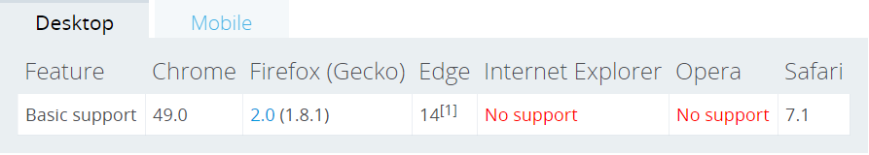
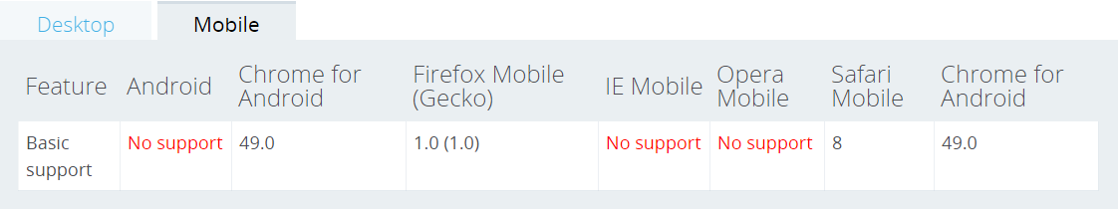
ECMAScript 6 & TypeScript
Browser Compatibility - Destructuring Assignment
76
copyright 2016 Trainologic LTD

Slide 77
ECMAScript 6 & TypeScript
Intro
Block Scoped Variables
Arrow Functions
Rest Parameters
Template Strings
Default Parameters
Computed Properties
Destructuring Assignment
for...of
for…of
77
copyright 2016 Trainologic LTD

Slide 78
ECMAScript 6 & TypeScript
for...of
Creates a loop iterating over all values of an iterable object
Iterable: Array, Map, Set, String, TypedArray, arguments
Each iteration invokes a custom iteration hook (callback)
Syntax: for (variable of iterable) { {statement} } for ([k, v] of iterable) { // key-value destructuring for Maps {statement} }
Note that for…of iterates over the iterable’s values, as opposed to for…in which iterates the iterable’s enumerable properties (keys)
78
copyright 2016 Trainologic LTD

Slide 79
ECMAScript 6 & TypeScript
Examples - for...of
Arrays and for...in vs. for…of
var houses = ["Lannister", "Bolton", "Greyjoy", "Arryn", "Baratheon", "Frey"]; // 0, 1, 2, 3, 4, 5 for (var house in houses) { console.log(house); } // "Lannister", "Bolton", "Greyjoy", "Arryn", "Baratheon", "Frey" for (var house of houses) { console.log(house); }
79
copyright 2016 Trainologic LTD

Slide 80
ECMAScript 6 & TypeScript
Examples - for...of
for...of with Maps
var books = new Map();
books.set(1, "A Game of Thrones"); books.set(2, "A Clash of Kings"); books.set(3, "A Storm of Swords");
// [1, "A Game of Thrones"], [2, "A Clash of Kings"], [3, "A Storm of Swords"]
for (var book of books) { console.log(book); }
// "A Game of Thrones", "A Clash of Kings", "A Storm of Swords" for (var [sequence, name] of books) { console.log(name); }
80
copyright 2016 Trainologic LTD

Slide 81
ECMAScript 6 & TypeScript
Examples - for...of
for...of with Maps
var books = new Map();
books.set(1, "A Game of Thrones"); books.set(2, "A Clash of Kings"); books.set(3, "A Storm of Swords");
// "A Game of Thrones", "A Clash of Kings", "A Storm of Swords" for (var name of books.keys()) { console.log(book); }
81
copyright 2016 Trainologic LTD

Slide 82
ECMAScript 6 & TypeScript
for...of & TS
TS transpiles for…of loops into a standard for (…) loop
var houses = ["Lannister", "Bolton", "Greyjoy", "Arryn", "Baratheon", "Frey"];
// no special transpiling with for…in loops for (var house in houses) { console.log(house); }
// transpiled into simple for (…) loop for (var _i = 0, houses_1 = houses; _i < houses_1.length; _i++) { var house = houses_1[_i]; console.log(house); }
82
copyright 2016 Trainologic LTD

Slide 83
ECMAScript 6 & TypeScript
for...of & TS
Same for Maps
var books = new Map();
books.set(1, "A Game of Thrones"); books.set(2, "A Clash of Kings"); books.set(3, "A Storm of Swords");
for (var _i = 0, books_1 = books; _i < books_1.length; _i++) { var book = books_1[_i]; console.log(book); }
83
copyright 2016 Trainologic LTD

Slide 84
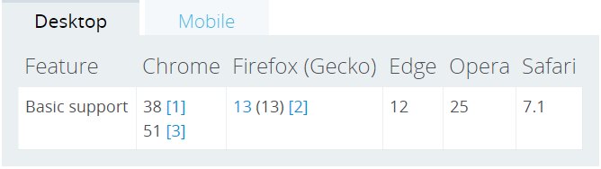

ECMAScript 6 & TypeScript
Browser Compatibility – for…of
84
copyright 2016 Trainologic LTD

Slide 85

ECMAScript 6 & TypeScript
85
copyright 2016 Trainologic LTD

Slide 86

ECMAScript 6
& TypeScript
-- PART 2 --
86
copyright 2016 Trainologic LTD

Slide 87
ECMAScript 6 & TypeScript
Enumerable Types
Modules
Types
Classes
Iterators
Generators
Promises
Maps, Sets & Friends
Enums
87
copyright 2016 Trainologic LTD

Slide 88
ECMAScript 6 & TypeScript
Enums
A way to organize a collection of related values
Enum members have numeric values associated with them and can be either constant or computed
TS Only. JS does not provide enums
Enums are number based
Syntax: enum EnumName { elem1 [= initializer1], elem2 [= initializer2], … elemN [= initializerN] }
88
copyright 2016 Trainologic LTD

Slide 89
ECMAScript 6 & TypeScript
Example
enum Characters { WalterWhite, SkylerWhite, SaulGoodman, JessePinkman, GusFring } var main = Characters.WalterWhite;
console.log(main); // 0
console.log(main === Characters.WalterWhite); // true
89
copyright 2016 Trainologic LTD

Slide 90
ECMAScript 6 & TypeScript
Enum Values
Enum members have numeric values associated with them
Generally:
First element receives a default value of 0
Other elements receive previous element’s value + 1
Multiple elements can have same value
However values can also be computed:
Expressions evaluating to a number
Expressions using previous members
Function calls
Some computed values are known & defined at compile time, others only at runtime (e.g. function calls)
90
copyright 2016 Trainologic LTD

Slide 91
ECMAScript 6 & TypeScript
Example
Object
1:"SkylerWhite"
2:"SaulGoodman"
20:"JessePinkman"
99:"GusFring"
GusFring:99
JessePinkman:20
SaulGoodman:2
SkylerWhite:1
WalterWhite:1
function getGusValue() { return 99; } enum Characters { WalterWhite = 1, SkylerWhite = WalterWhite, // also 1 SaulGoodman, // = 2 (prev + 1) JessePinkman = 10 * SaulGoodman, GusFring = getGusValue() } console.dir(Characters);
91
copyright 2016 Trainologic LTD

Slide 92
ECMAScript 6 & TypeScript
Which Transpiles to…
function getGusValue() { return 99; }
var Characters;
(function (Characters) { Characters[Characters["WalterWhite"] = 1] = "WalterWhite"; Characters[Characters["SkylerWhite"] = 1] = "SkylerWhite"; Characters[Characters["SaulGoodman"] = 2] = "SaulGoodman"; Characters[Characters["JessePinkman"] = 20] = "JessePinkman"; Characters[Characters["GusFring"] = getGusValue()] = "GusFring"; })(Characters || (Characters = {}));
console.dir(Characters);
92
copyright 2016 Trainologic LTD

Slide 93
ECMAScript 6 & TypeScript
Const Enums
TS generated an object with both forward (name -> value) and reverse (value -> name) mappings, as we’ve seen earlier
References to enum members are always emitted as property accesses, example:
console.log(Characters.JessePinkman);
For a performance boost we can create const enums
Const enum references use inline values
But then we can’t use computed members ☹
93
copyright 2016 Trainologic LTD

Slide 94
ECMAScript 6 & TypeScript
Example
const enum Characters { WalterWhite = 1, SkylerWhite = WalterWhite, SaulGoodman, JessePinkman = 10 * SaulGoodman, // sorry, no computed values allowed ☹ */ GusFring = 99 /* getGusValue() */ } console.log(Characters.JessePinkman);
94
copyright 2016 Trainologic LTD

Slide 95
ECMAScript 6 & TypeScript
Which Transpiles to…
// no enum object created
// values are inlined
console.log(20 /* JessePinkman */);
95
copyright 2016 Trainologic LTD

Slide 96
ECMAScript 6 & TypeScript
Browser Compatibility
This is a TypeScript specific feature not supported natively by JS
96
copyright 2016 Trainologic LTD

Slide 97
ECMAScript 6 & TypeScript
Enumerable Types
Modules
Types
Classes
Iterators
Generators
Promises
Maps, Sets & Friends
Modules
97
copyright 2016 Trainologic LTD

Slide 98
ECMAScript 6 & TypeScript
Modules
Before ES6, JS did not have modules, and so libraries were used instead. Now, ES6 finally introduced modules.
Modules are executed within their own scope: declarations do not pollute the global namespace
Modules are stored in files: one module per file
Module name is the file name (w/o extension)
The export and import statements are used to import/export module declarations respectively
Two export types exist: named and default
Named exports are useful to export several values
Default exports are considered the “main” exported module value. Limited to single default per module.
98
copyright 2016 Trainologic LTD

Slide 99
ECMAScript 6 & TypeScript
Example – Named Exports
/* calculator.js */
const COEFFICIENT = 42;
export function calculate(x, y) {
return x + COEFFICIENT * y;
}
export { COEFFICIENT };
/* application.js */
import { calculate, COEFFICIENT } from "./calculator";
console.log(calculate(10, 20)); // 42 console.log(COEFFICIENT); // 850
99
copyright 2016 Trainologic LTD

Slide 100
ECMAScript 6 & TypeScript
Example – Default Exports
/* calculator.js */
const COEFFICIENT = 42;
export default function calculate(x, y) {
return x + COEFFICIENT * y;
}
/* application.js */
import calculate from "./calculator"; // no curly braces around calculate
console.log(calculate(10, 20)); // 850
100
copyright 2016 Trainologic LTD

Slide 101
ECMAScript 6 & TypeScript
A Word about Module Loaders
As we’ve seen, modules can import/use one another
The actual module files loading is performed by a module loader, responsible for:
Locating the module files
Fetching/loading them into memory
Handling module dependencies
Executing their code
This is usually done in runtime (although can be done in compile time e.g. for dist bundling)
Common module loaders include requirejs and systemjs
101
copyright 2016 Trainologic LTD

Slide 102
ECMAScript 6 & TypeScript
TS & Modules
TS needs to know which module loader we will be using, as the compilation output differs for each one
We define it using the compiler module option:
We will now see how TS transpiles modules to be used for commonjs
// tsconfig.json
{ "compilerOptions": { "target": “es6", "module": "commonjs“ // other options: amd, system, es6, umd } }
102
copyright 2016 Trainologic LTD

Slide 103
ECMAScript 6 & TypeScript
Modules & TS – Named Exports
/* calculator.js */
var COEFFICIENT = 42; exports.COEFFICIENT = COEFFICIENT;
function calculate(x, y) { return x + COEFFICIENT * y; } exports.calculate = calculate;
/* application.js */
var calculator_1 = require("./calculator");
console.log(calculator_1.calculate(10, 20)); console.log(calculator_1.COEFFICIENT);
103
copyright 2016 Trainologic LTD

Slide 104
ECMAScript 6 & TypeScript
Modules & TS – Default Exports
/* calculator.js */
var COEFFICIENT = 42;
function calculate(x, y) { return x + COEFFICIENT * y; }
// module mode marker for interoperability Object.defineProperty(exports, "__esModule", { value: true }); exports.default = calculate; // actual exported default value
/* application.js */
var calculator_1 = require("./calculator");
console.log(calculator_1.default(10, 20)); // imported as “default”
104
copyright 2016 Trainologic LTD

Slide 105
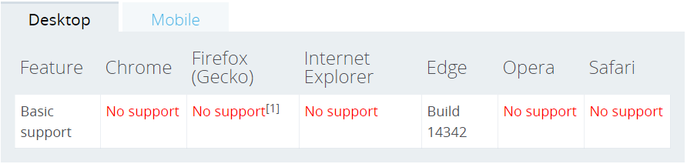

ECMAScript 6 & TypeScript
Browser Compatibility - import
105
copyright 2016 Trainologic LTD

Slide 106
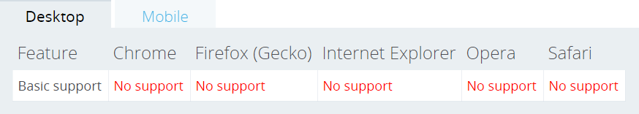
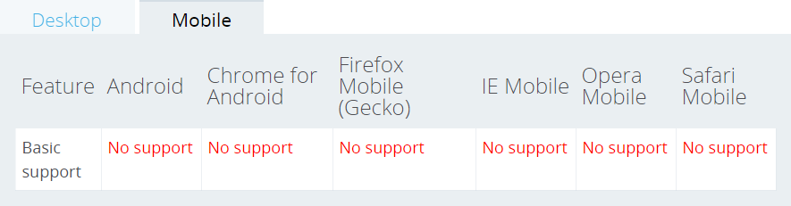
ECMAScript 6 & TypeScript
Browser Compatibility - export
106
copyright 2016 Trainologic LTD

Slide 107
ECMAScript 6 & TypeScript
Enumerable Types
Modules
Types
Classes
Iterators
Generators
Promises
Maps, Sets & Friends
Types
107
copyright 2016 Trainologic LTD

Slide 108
ECMAScript 6 & TypeScript
Types
One of the main goals/reasons for using TypeScript
Types enhance code quality and understandability, and allow us to catch errors at compile time
JS natively has six (6) primitive data types:
string
number
boolean
null
undefined
symbol ← new in ES6
TS uses these (and more e.g. interfaces, classes, arrays, …) for its typing system
108
copyright 2016 Trainologic LTD

Slide 109
ECMAScript 6 & TypeScript
Implicit Typing
TS does not force using types; they are intentionally optional
Any plain JS can be renamed .js -> .ts an will still compile
TS attempts to infer types from the code and provide compile time type safety
However, using explicit types (next slide) greatly improve TS’s ability to warn us of potential errors/bugs
var mynumber = 42; // TS implicitly infers type number
mynumber = "great number“; // assignment of a string value into a number typed var
// will compile but raise a compile time error
// Error: TS2322: Type 'string' is not assignable to type 'number'.
109
copyright 2016 Trainologic LTD

Slide 110
ECMAScript 6 & TypeScript
Explicit Typing
The basic type annotations are as follows:
Anything that is available in the type declaration space can be used as a type annotation
The declaration space includes JS primitive types, interfaces, enums, functions, classes, arrays
var base: number = 123;
function multiply (num: number): number {
return base * num;
}
110
copyright 2016 Trainologic LTD

Slide 111
ECMAScript 6 & TypeScript
Primitives & Arrays
var num: number;
var str: string;
var bool: boolean;
num = 123;
num = 123.456;
num = '123'; // Error
str = '123';
str = 123; // Error
bool = true;
bool = false;
bool = 'false'; // Error
var boolArray: boolean[];
boolArray = [true, false];
console.log(boolArray[0]); // true
console.log(boolArray.length); // 2
boolArray[1] = true;
boolArray = [false, false];
boolArray[0] = 'false'; // Error!
boolArray = 'false'; // Error!
boolArray = [true, 'false']; // Error!
111
copyright 2016 Trainologic LTD

Slide 112
ECMAScript 6 & TypeScript
Interfaces
TS’s primary way for composing multiple type annotations into a single named annotation
interface Name {
first: string;
second: string;
}
var name: Name;
name = { first: 'John', second: 'Doe’ }; // Okay
name = { first: 'John‘ }; // Error : `second` is missing
name = { first: 'John', second: 1337 }; // Error : `second` is the wrong type
112
copyright 2016 Trainologic LTD

Slide 113
ECMAScript 6 & TypeScript
Inline Type Annotation
Instead of creating an interface we can annotate inline
Great for quickly providing a one off type annotation
However, if repeatedly used consider refactoring into an interface (or a type alias covered later)
var name: {
first: string;
second: string;
};
name = { first: 'John', second: 'Doe’ }; // Okay
name = { first: 'John‘ }; // Error : `second` is missing
name = { first: 'John', second: 1337 }; // Error : `second` is the wrong type
113
copyright 2016 Trainologic LTD

Slide 114
ECMAScript 6 & TypeScript
Special Types - any
Beyond the primitive types there are few types with special meaning in TS: any, null, undefined, void
any:
Compatible with all types
Tells the compiler not to do any meaningful static analysis
var power: any;
// takes any and all types
power = '123'; // number
power = 123; // string
// compatible with all types
var num: number;
power = num;
num = power;
114
copyright 2016 Trainologic LTD

Slide 115
ECMAScript 6 & TypeScript
Special Types – null & undefined
treated the same as something of type any
These literals can be assigned to any other type
var num: number;
var str: string;
// these literals can be assigned to anything
num = null;
str = undefined;
115
copyright 2016 Trainologic LTD

Slide 116
ECMAScript 6 & TypeScript
Special Types – void
Use :void to signify that a function has no return type (and value)
function log(message: string): void {
console.log(message);
}
116
copyright 2016 Trainologic LTD

Slide 117
ECMAScript 6 & TypeScript
Function Types
Parameter & Return Type annotations
Optional Parameters
interface Person {
name: string;
age: number;
}
function getAge (person: Person): number {
return person.age;
}
function addCharacter (name: string, age?: number): void { // .. } addCharacter('Jon Snow', 24);
addCharacter('Sansa Stark'); // okay, age is optional
117
copyright 2016 Trainologic LTD

Slide 118
ECMAScript 6 & TypeScript
Function Overloading
Allows us to define two or more functions with the same name but different signatures
class Person { constructor(public name:string, public age:number) {} } function getAge (x: Person[]): number; function getAge (x: Person): number { if (x instanceof Person) { return x.age; } return group.map(p => p.age ).reduce((a1, a2) => (a1 + a2), 0); } var group = []; group.push(new Person('Jack', 30)); group.push(new Person('Jill', 28)); group.push(new Person('Dave', 15)); console.log(getAge(group[0])); // 30 console.log(getAge(group)); // 73
118
copyright 2016 Trainologic LTD

Slide 119
ECMAScript 6 & TypeScript
Type Guards
Allows narrowing down an object type within conditional block
TS understands the variable type within that conditional block
We can even create user defined type guards (out of scope)
// as seen in previous example
if (x instanceof Person) { // TS understands that within this block x is a of type Person return x.age; // and therefore allows us to access the ‘age’ property
}
119
copyright 2016 Trainologic LTD

Slide 120
ECMAScript 6 & TypeScript
Generics
Many algorithms and data structures in computer science do not depend on the actual type of the object
Allows us to define functions, classes and interfaces that are based on type parameters
// function based on the type parameter T
function reverse<T>(items: T[]): T[] {
var reversed = [];
for (let i = items.length - 1; i >= 0; i--) {
reversed.push(items[i]);
}
return reversed ;
}
var numArr = [1, 2, 3]; // implicitly typed as :number[]
var numArrRev = reverse(numArr); // returns an array of type :number[] , with values = 3,2,1
var strArr = [‘one’, ‘two’]; // implicitly typed as :string[]
var strArrRev = reverse(strArr); // returns an array of type :string[] , with values = ‘two’, ‘one’
120
copyright 2016 Trainologic LTD

Slide 121
ECMAScript 6 & TypeScript
Generics
As a matter of fact, JS string’s prototype already has a .reverse() function
TS itself uses generics to define its structure (in lib.d.ts)
Meaning we get type safety when calling .reverse() on any array
/////////////////////////////
/// ECMAScript Array API (specially handled by compiler)
/////////////////////////////
interface Array<T> {
/**
* Reverses the elements in an Array.
*/
reverse(): T[];
121
copyright 2016 Trainologic LTD

Slide 122
ECMAScript 6 & TypeScript
Union Type
Allows a property to be one of multiple types (e.g string or a number)
Denoted by the pipe sign | in a type annotation (e.g. string|number)
// can take a string or array of strings
function formatCommandline(command: string[ ]|string) {
var line = '';
if (typeof command === 'string') {
line = command.trim();
} else {
line = command.join(' ').trim();
}
// do stuff with line:string …
}
122
copyright 2016 Trainologic LTD

Slide 123
ECMAScript 6 & TypeScript
Intersection Type
Allows us to define a type having members of several types
Commonly used for mixins (which are convenient replacement for multiple inheritance we don’t have in JS)
Note we’re not limited to two types only (e.g. T & U & V & W)
function extend<T, U>(first: T, second: U): T & U {
let result = <T & U> {};
for (let id in first) {
result[id] = first[id];
}
for (let id in second) {
if (!result.hasOwnProperty(id)) {
result[id] = second[id];
}
}
return result;
}
var x = extend({ a: "hello" }, { b: 42 }); // x now has both `a` and `b`
console.log(x.a, x.b); // hello 42
123
copyright 2016 Trainologic LTD

Slide 124
ECMAScript 6 & TypeScript
Tuple Type
Tuples are finite ordered list of elements
Syntax :[type1, type2, … typeN]
var nameNumber: [string, number];
nameNumber = ['Saul Goodman', 5055034455]; // Okay
nameNumber = ['Saul Goodman', '5055034455']; // Error!
var [name, num] = nameNumber; // destructure
124
copyright 2016 Trainologic LTD

Slide 125
ECMAScript 6 & TypeScript
Type Alias
Used for providing names for reusable type annotations
Syntax type someName = anyValidTypeAnnotation
Type aliases can be created for any type really
type StrOrNum = string|number;
var sample: StrOrNum; // used like any other notation
sample = 123; // okay
sample = '123'; // okay
sample = true; // error
type Text = string | { text: string }; // union
type Coordinates = [number, number]; // tuple
type Callback = (data: string) => void; // callback
125
copyright 2016 Trainologic LTD

Slide 126
ECMAScript 6 & TypeScript
lib.d.ts
A special declaration file that ships with every TS installation
Contains the ambient declarations (next slide) for common JS constructs (JS runtimes and the DOM)
Automatically included in compilation context of TS projects
Makes it easy for us to start writing type checked JS code
var foo = 123;
var bar = foo.toString(); // okay since lib.d.ts is included
// but if we set compiler flag to noLib: true in tsconfig.json then …
var bar = foo.toString(); // ERROR: Property 'toString' does not exist on type 'number'.
126
copyright 2016 Trainologic LTD

Slide 127
ECMAScript 6 & TypeScript
Ambient Declarations
Used to provide type information (definitions) for existing JS code / libraries, either 3rd party or our own
Contain the type information but not the implementation
This provides us with type-checking and auto-completion without the need to re-write the code in TS
Files usually end with a .d.ts extension
There are many ambient declarations already written for us (jquery, angular, moment, …)
We can use dev tools such as Typings for fetching existing .d.ts files
.d.ts files are actually a great source for documentation and good declaration practices to learn from
127
copyright 2016 Trainologic LTD

Slide 128
ECMAScript 6 & TypeScript
JS & Types
The typing system we covered is TS specific
JS knows nothing about it
All types are completely removed when transpiled
class Person { constructor(public name:string, public age:number) { } } function getAge(x: Person[]): number; function getAge(x: Person): number { if (x instanceof Person) { return x.age; } return group.map(p => p.age )
.reduce((a1, a2) => (a1 + a2), 0); }
var Person = (function () { function Person(name, age) { this.name = name; this.age = age; } return Person; }());
function getAge(x) { if (x instanceof Person) { return x.age; } return group.map(function (p) { return p.age; })
.reduce(function (a1, a2) { return (a1 + a2); }, 0); }
128
copyright 2016 Trainologic LTD

Slide 129
ECMAScript 6 & TypeScript
Enumerable Types
Modules
Types
Types
Iterators
Generators
Promises
Maps, Sets & Friends
Classes
129
copyright 2016 Trainologic LTD

Slide 130
ECMAScript 6 & TypeScript
Classes
ES5 classes are syntactic sugar over prototypical inheritance
Classes provide simpler & clearer syntax for dealing with inheritance
Classes can be defined in similar manner to function expressions and function declarations:
// class declaration class Point { constructor(x, y) { this.x = x; this.y = y; } }
var p = new Point(10, 20);
// class expression var Point = class { constructor(x, y) { this.x = x; this.y = y; } }
var p = new Point(10, 20);
130
copyright 2016 Trainologic LTD

Slide 131
ECMAScript 6 & TypeScript
Classes – Hoisting
As opposed to function declarations, class declarations are not hoisted
Thus class declarations cannot be used before the declaration
// ReferenceError ! var p = new Point(10, 20);
// class declaration class Point { constructor(x, y) { this.x = x; this.y = y; } }
// Okay var f = calc(10, 20);
// function declaration function calc (x, y) { return x * y; }
131
copyright 2016 Trainologic LTD

Slide 132
ECMAScript 6 & TypeScript
Classes – Body & CTor
The body class is the part within the curly braces {}
This is where we define properties and methods
Body code is executed in strict mode
One special method is the constructor, for creating and initializing a class object instance
class Point { // body starts here constructor(x, y) { this.x = x; this.y = y;
console.log(‘new point created’); } } // body ends here
132
copyright 2016 Trainologic LTD

Slide 133
ECMAScript 6 & TypeScript
Classes – Prototype Methods
Methods are defined within the body as follows
class Westeros {
this.kingdoms = [];
this.maxKingdoms = 7;
constructor() {
console.log(“Westeros initialized”); }
addKingdom(name) {
if (this.kingdoms.length >= 7) {
console.log(“Sorry, max kingdoms reached”);
return;
}
this.kingdoms.push(name);
} }
133
copyright 2016 Trainologic LTD

Slide 134
ECMAScript 6 & TypeScript
Classes - Sub Classing
The extends keyword is used to create a child class (sub-class)
A class can only have a single superclass (i.e. single inheritance)
The super keyword is used to access the parent class
super() invokes the object’s parent constructor
super.someMethod() invokes someMethod on the object's parent
class Dothraki { constructor(name) { this.name = name;
console.log(
name + “ created”); } }
class DothrakiWarrior extends Dothraki{ constructor(name, weapon) {
super(name); this.weapon= weapon;
console.log(“Weapon = “ + weapon); } }
var khalDrogo = new DothrakiWarrior(“Khal Drogo”, “Sword”);
// Khal Drogo created \n Weapon = Sword
134
copyright 2016 Trainologic LTD

Slide 135
ECMAScript 6 & TypeScript
Classes – Static Methods
The static keyword defines static methods (shared across all class instances)
They are called using the class name (not an instance)
class Dothraki { constructor(name) { this.name = name; console.log(name + " created"); } static greet() { console.log("Hello, kirekosi are yeri?"); } }
console.log(Dothraki.greet()); // Hello, kirekosi are yeri?
135
copyright 2016 Trainologic LTD

Slide 136
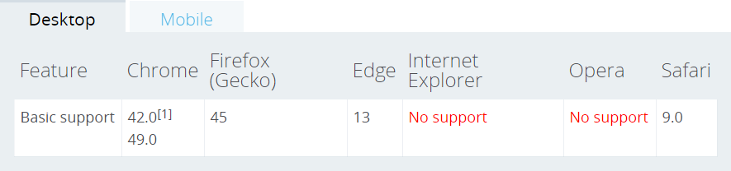
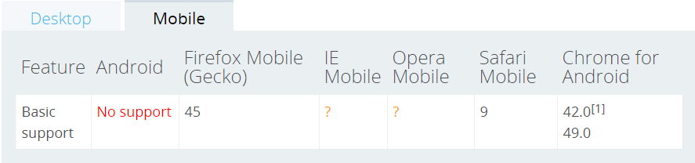
ECMAScript 6 & TypeScript
Browser Compatibility - Classes
136
copyright 2016 Trainologic LTD

Slide 137
ECMAScript 6 & TypeScript
Classes & TS
TypeScript’s classes have some additional features which do not exist in ES6:
Types: covered in previous section
Properties: class value members (as opposed to methods)
Access Modifiers* determine accessibility to class members:
* At runtime these have no significance, but will raise errors in compile time if you incorrectly used.
Accessible On | public | private | protected
Class instances | yes | no | no
Class | yes | yes | yes
Class children | yes | no | yes
137
copyright 2016 Trainologic LTD

Slide 138
ECMAScript 6 & TypeScript
Classes – TS - Example
class Point {
x: number;
y: number;
static instances: number = 0;
constructor(x: number, y: number) {
this.x = x;
this.y = y;
Point.instances++;
}
add(point: Point) {
return new Point(this.x + point.x, this.y + point.y);
}
static printNumInstances() { console.log("There are " + Point.instances + " points"); }
}
var p1 = new Point(0, 10);
var p2 = new Point(10, 20);
var p3 = p1.add(p2); // {x:10,y:30}
Point.printNumInstances(); // There are 3 points
138
copyright 2016 Trainologic LTD

Slide 139
ECMAScript 6 & TypeScript
Classes – TS - Transpiled
class Point {
x: number;
y: number;
static instances: number = 0;
constructor(x: number, y: number) {
this.x = x;
this.y = y;
Point.instances++;
}
add(point: Point) {
return new Point( this.x + point.x, this.y + point.y);
}
static printNumInstances() { console.log("There are " + Point.instances + " points"); }
}
var Point = (function () {
function Point (x, y) { Point.instances++; }
Point.prototype.add = function (point) { return new Point( this.x + point.x, this.y + point.y); };
Point.printNumInstances = function () { console.log("There are " + Point.instances + " points"); };
Point.instances = 0;
return Point;
}());
139
copyright 2016 Trainologic LTD

Slide 140
ECMAScript 6 & TypeScript
Classes – Define Using Constructor
A very common class member initialization is:
TS thus provides a convenient shorthand annotation that does the same:
class Foo {
x: number;
constructor(x:number) {
this.x = x;
}
}
class Foo {
constructor(public x:number) {
}
}
140
copyright 2016 Trainologic LTD

Slide 141
ECMAScript 6 & TypeScript
Define Using Constructor – TS - Transpiled
class Foo {
constructor(public x:number) { }
}
var Foo = (function () {
function Foo(x) { this.x = x; }
return Foo;
}());
141
copyright 2016 Trainologic LTD

Slide 142
ECMAScript 6 & TypeScript
Enumerable Types
Modules
Types
Types
Iterators
Generators
Promises
Maps, Sets & Friends
Iterators
142
copyright 2016 Trainologic LTD

Slide 143
ECMAScript 6 & TypeScript
Iterators
Iterators are a Behavioral Design Pattern common for OOP languages
Used for processing/going over collations, which is a very common task
Iterators bring the iteration concept directly into core JS
Provide a mechanism for customizing the behavior of for…of loops
Iterators are objects that know how to access collection items one at a time, keeping track of the current item
An iterator’s next() method returns an object with two properties:
done – boolean indicating whether no more items left
value – the item value
143
copyright 2016 Trainologic LTD

Slide 144
ECMAScript 6 & TypeScript
Example
function makeOddIterator (array){ var nextIndex = 0;
return { // the iterator next: function() { var retval = nextIndex < array.length ? {value: array[nextIndex], done: false} : {done: true}; nextIndex += 2; return retval; } } } var iter = makeOddIterator(['one', 'two', 'three', 'four', 'five', 'six', 'seven', 'eight']);
for (var item = iter.next(); !item.done; item = iter.next()) { console.log(item.value); }
// one, three, five, seven
144
copyright 2016 Trainologic LTD

Slide 145
ECMAScript 6 & TypeScript
Iterables
An object is iterable if it defines its iteration behavior
Such as which values are looped over in a for..of construct
To be iterable, an object must implement the @@iterator method
Some built-in types, such as Array or Map, have a default iteration behavior (e.g. Array, Map, String), while others (e.g Object) do not
Some statements and expressions actually expect iterables:
for(let value of ["a", "b", "c"]){ // for...of loop
// ...
}
[..."abc"]; // ["a", "b", "c"] // spread operator
[a, b, c] = new Set(["a", "b", "c"]); // destructuring assignment
145
copyright 2016 Trainologic LTD

Slide 146
ECMAScript 6 & TypeScript
User Defined Iterable - ES6
let iterable = {
0: 'a',
1: 'b',
2: 'c',
length: 3,
[Symbol.iterator]() {
let index = 0;
return {
next: () => {
let value = this[index];
let done = index >= this.length;
index++;
return { value, done };
}
};
}
};
for (let item of iterable) {
console.log(item); // 'a', 'b', 'c'
}
146
copyright 2016 Trainologic LTD

Slide 147
ECMAScript 6 & TypeScript
User Defined Iterable - TS
class IterableStuffCollection implements IterableIterator<any> {
private pointer = 0; constructor(private stuff:any[]) { } public next():IteratorResult<any> { let value = this.stuff[this.pointer]; let done = this.pointer >= this.stuff.length; this.pointer++; return {value, done}; } [Symbol.iterator]():IterableIterator<any> { return this; } } var myStuff = new IterableStuffCollection(['XBox One', 42, Math.PI, 'pokemon go', {oh: 'yeah'}]); for (let item of myStuff) { console.log(item); }
// XBox One, 42, 3.141592653589793, pokemon go, { oh: 'yeah' }
147
copyright 2016 Trainologic LTD

Slide 148
ECMAScript 6 & TypeScript
User Defined Iterable – TS - Notes
Previous code example require ES6 target
It could also work with ES5 target, but will require:
JS engine supporting Symbol.iterator (nodejs 4+, Google Chrome)
Using ES6 lib with ES5 target (add es6.d.ts to your project)
// tsconfig.json
"compilerOptions": { "target": "ES6“ }
// lib.es6.d.ts
interface IterableIterator<T> extends Iterator<T> { [Symbol.iterator](): IterableIterator<T>; }
148
copyright 2016 Trainologic LTD

Slide 149
ECMAScript 6 & TypeScript
TS Transpiled Code
class IterableStuffCollection { constructor(stuff) { this.stuff = stuff; this.pointer = 0; } next() { let value = this.stuff[this.pointer]; let done = this.pointer >= this.stuff.length; this.pointer++; return { value: value, done: done }; } [Symbol.iterator]() { // note that ES6 Symbol.iterator / iteration protocol is required return this; } } var myStuff = new IterableStuffCollection(['XBox One', 42, Math.PI, 'pokemon go', { oh: 'yeah' }]); for (let item of myStuff) { console.log(item); }
149
copyright 2016 Trainologic LTD

Slide 150
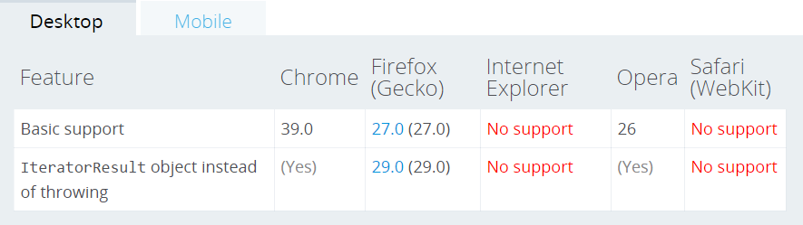
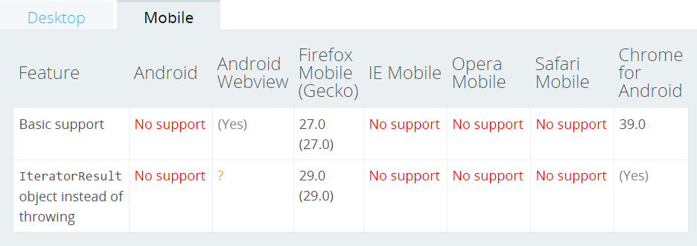
ECMAScript 6 & TypeScript
Browser Compatibility
150
copyright 2016 Trainologic LTD

Slide 151
ECMAScript 6 & TypeScript
Enumerable Types
Modules
Types
Types
Iterators
Generators
Promises
Maps, Sets & Friends
Generators
151
copyright 2016 Trainologic LTD

Slide 152
ECMAScript 6 & TypeScript
Generators
Generators are a new breed of functions in JS, with a new syntax: function *
Calling a generator function does not execute its body immediately
Instead, an iterator object for the function is returned
We then iterate the generator by repeatedly calling next()
next() executes the body function until the next yield expression returns a value
Since the generator is really a function, we can call next() with arguments
Execution can be further delegated to another generator function using a yield * generator expression
152
copyright 2016 Trainologic LTD

Slide 153
ECMAScript 6 & TypeScript
Generators - Motivation
Lazy Iterators – examples:
Return a finite or infinite list of values
Lazy execution/loading
Externally Controlled Execution
Allows a function to pause execution and pass control to the caller
Re-entering the function again later, while keeping context (variable bindings) across re-entrances
We can control its behavior by passing arguments to the generator
153
copyright 2016 Trainologic LTD

Slide 154
ECMAScript 6 & TypeScript
Generators – Lazy Iteration
function* idMaker() { // generator function
var index = 0;
while(index < 3) // note this is a finite iterator
yield index++;
}
var gen = idMaker(); // returns iterator
console.log(gen.next().value); // 0
console.log(gen.next().value); // 1
console.log(gen.next().value); // 2
console.log(gen.next().value); // undefined
dsds
154
copyright 2016 Trainologic LTD

Slide 155
ECMAScript 6 & TypeScript
Generators – Function Args
function* addCallNumber (base) { var callNumber = 0; while (true) { yield base + callNumber++; } } var gen = addCallNumber(10); // invoke generator with argument(s) console.log(gen.next().value); // 10 console.log(gen.next().value); // 11 console.log(gen.next().value); // 12
dsds
155
copyright 2016 Trainologic LTD

Slide 156
ECMAScript 6 & TypeScript
Passing Arguments Into Generators
"use strict"; function* showPrevCurrGenerator() { var prev, curr; while (true) { console.log('-------'); prev = curr; curr = yield; console.log('prev = ' + prev); console.log('curr = ' + curr); } } var gen = showPrevCurrGenerator(); gen.next(); // executes until the first yield gen.next('First'); gen.next('Second'); gen.next('Third');
dsds
-------
prev = undefined
curr = First
-------
prev = First
curr = Second
-------
prev = Second
curr = Third
-------
156
copyright 2016 Trainologic LTD

Slide 157
ECMAScript 6 & TypeScript
Generators – yield*
function* anotherGenerator(i) { yield i + 0.1; yield i + 0.2; yield i + 0.3; } function* generator(i){ yield '0.01'; yield* anotherGenerator(i); yield i * 10; } var gen = generator(10); console.log(gen.next().value); // 0.01 console.log(gen.next().value); // 10.1 console.log(gen.next().value); // 10.2 console.log(gen.next().value); // 10.3 console.log(gen.next().value); // 100
dsds
157
copyright 2016 Trainologic LTD

Slide 158
ECMAScript 6 & TypeScript
TS Transpiled Code
// This is a pure ES6 feature, TS doesn't do any magic
// Generators require ES6 support in the browser/node
function* idMaker() { var index = 0; while (index < 3) { yield index++;
} }
158
copyright 2016 Trainologic LTD

Slide 159
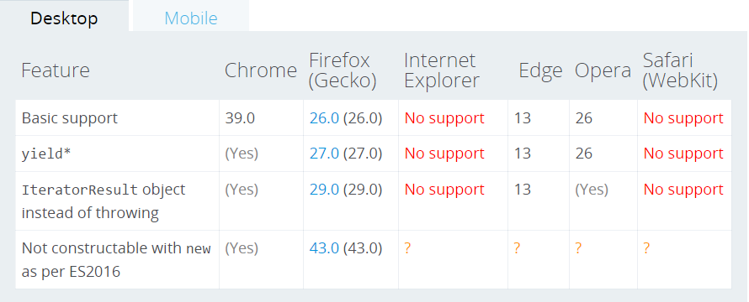
ECMAScript 6 & TypeScript
Browser Compatibility - Desktop
159
copyright 2016 Trainologic LTD

Slide 160
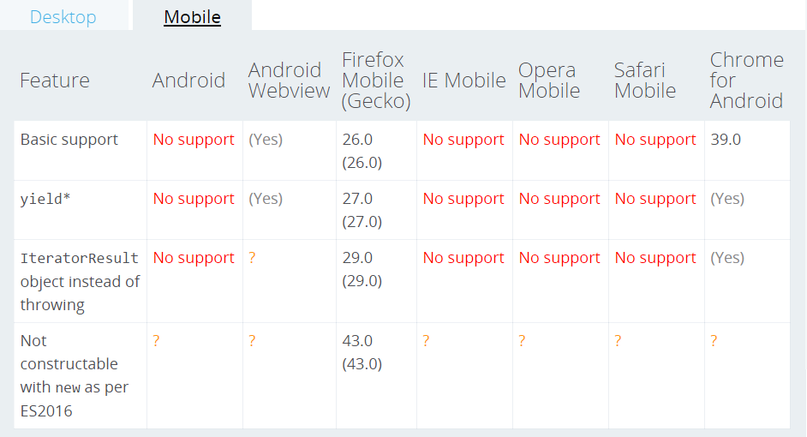
ECMAScript 6 & TypeScript
Browser Compatibility - Mobile
160
copyright 2016 Trainologic LTD

Slide 161
ECMAScript 6 & TypeScript
Enumerable Types
Modules
Types
Types
Iterators
Generators
Promises
Maps, Sets & Friends
Promises
161
copyright 2016 Trainologic LTD

Slide 162
ECMAScript 6 & TypeScript
Promises
A Promise represents an operation that hasn't completed yet, but is expected in the future
Used for asynchronous computations
Promises are chainable. This is a key benefit
Syntax: new Promise(function(resolve, reject) { ... } );
The promise Ctor takes a single argument: an executor function
Executed immediately (even before returning the new Promise object)
resolve and reject functions are bound to the promise and calling them fulfills or rejects the promise, respectively
The executor function is expected to initiate some async work, and then invoke either resolve or reject
162
copyright 2016 Trainologic LTD

Slide 163
ECMAScript 6 & TypeScript
Promise States
Pending
With a value
With a reason
Fulfilled
Rejected
SETTLED
163
copyright 2016 Trainologic LTD

Slide 164
ECMAScript 6 & TypeScript
Methods - then
Promise.then(onFulfilled, onRejected)
Appends fulfillment and rejection handlers to the promise
Returns a new promise resolving to
The return value of the called handler (onFulfilled / onRejected)
Or to its original settled value if the promise was not handled (i.e. if the relevant handler onFulfilled or onRejected are not a function)
We say that promises are “thenable” objects
Allows us to create chains since then() returns a promise
We call this “composition”
164
copyright 2016 Trainologic LTD

Slide 165
ECMAScript 6 & TypeScript
Methods – catch
Promise.catch(onRejected)
Appends a rejection handler callback to the promise
Returns a new promise resolving to
The return value of the callback if it is called
Or to original fulfillment value if the promise is fulfilled
Allows us to create chains since catch() returns a promise
165
copyright 2016 Trainologic LTD

Slide 166
ECMAScript 6 & TypeScript
Methods – Other
Promise.all(iterable)
Takes a list of promises and returns a promise that
Resolves when all promises resolve
Or rejects as soon as any promise fails
Promise.race(iterable)
Takes a list of promises and returns a promise that
Resolves as soon as any promise resolves
Or rejects as soon as any promise rejects
Promise.resolve(value) / Promise.reject(reason)
Shortcuts returning an already resolved/rejected promise
Useful for example for initiating a chain
166
copyright 2016 Trainologic LTD

Slide 167
ECMAScript 6 & TypeScript
Example - Chaining
Promise.resolve(123)
.then((res) => {
console.log(res); // 123
return 456;
})
.then((res) => {
console.log(res); // 456
return Promise.resolve(123);
})
.then((res) => {
console.log(res); // 123 : Notice `this` is called with the resolved value
return Promise.resolve(123);
})
dsds
167
copyright 2016 Trainologic LTD

Slide 168
ECMAScript 6 & TypeScript
Example – Aggregated Error Handling
Promise.reject(new Error('something bad happened'))
.then((res) => {
console.log(res); // not called
return 456;
})
.then((res) => {
console.log(res); // not called
return Promise.resolve(123);
})
.then((res) => {
console.log(res); // not called
return Promise.resolve(123);
})
.catch((err) => {
console.log(err.message); // something bad happened
});
dsds
168
copyright 2016 Trainologic LTD

Slide 169
ECMAScript 6 & TypeScript
Example – catch Chaining
Promise.reject(new Error('something bad happened'))
.then((res) => {
console.log(res); // not called
return 456;
})
.catch((err) => {
console.log(err.message); // something bad happened
return Promise.resolve(123);
})
.then((res) => {
console.log(res); // 123
});
dsds
169
copyright 2016 Trainologic LTD

Slide 170
ECMAScript 6 & TypeScript
TS & Promises
TS understands promises flow of values
Promise.resolve(123)
.then((res)=>{
// res is inferred to be of type `number`
return true;
})
.then((res) => {
// res is inferred to be of type `boolean`
});
170
copyright 2016 Trainologic LTD

Slide 171
ECMAScript 6 & TypeScript
TS & Promises – cont.
TS also understands unwrapping function calls that return a promise
function iReturnPromiseAfter1Second():Promise<string> {
return new Promise((resolve)=>{
setTimeout(()=>resolve("Hello world!"), 1000);
});
}
Promise.resolve(123)
.then((res)=>{
// res is inferred to be of type `number`
return iReturnPromiseAfter1Second();
})
.then((res) => {
// res is inferred to be of type `string`
console.log(res); // Hello world!
});
171
copyright 2016 Trainologic LTD

Slide 172
ECMAScript 6 & TypeScript
TS – Converting CB to Promise
import fs = require('fs');
function readFileAsync (filename:string):Promise<any> {
return new Promise((resolve,reject)=> {
fs.readFile(filename,(err,result) => {
if (err) reject(err);
else resolve(result);
});
});
}
dsds
172
copyright 2016 Trainologic LTD

Slide 173
ECMAScript 6 & TypeScript
TS – Transpiled Code
TS does not do any “magic” with promises
It relies on ES6 promises or a polyfill
function iReturnPromiseAfter1Second() { return new Promise((resolve) => { setTimeout(() => resolve("Hello world!"), 1000); }); } Promise.resolve(123) .then((res) => { return iReturnPromiseAfter1Second(); }) .then((res) => { console.log(res); // Hello world! });
173
copyright 2016 Trainologic LTD

Slide 174
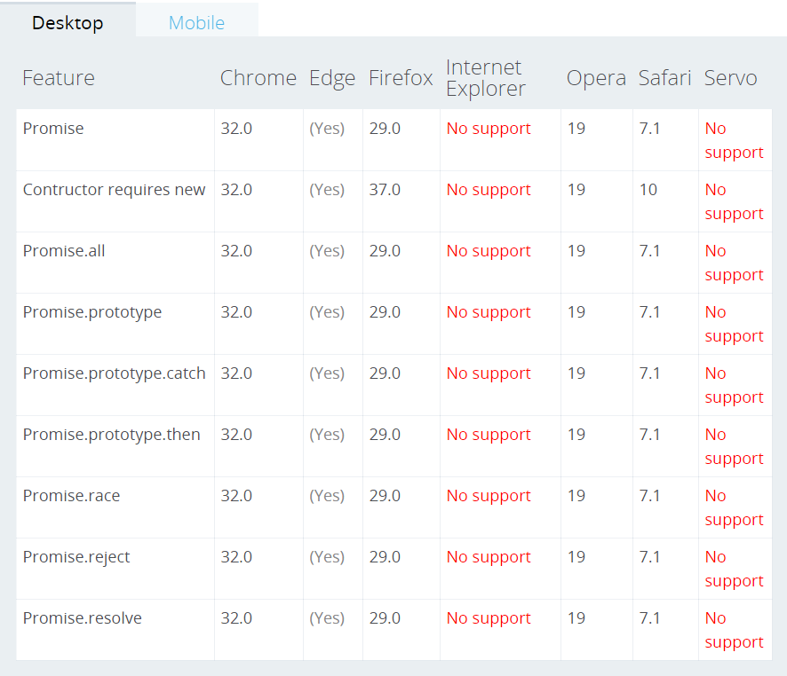
ECMAScript 6 & TypeScript
Browser Compatibility - Desktop
174
copyright 2016 Trainologic LTD

Slide 175
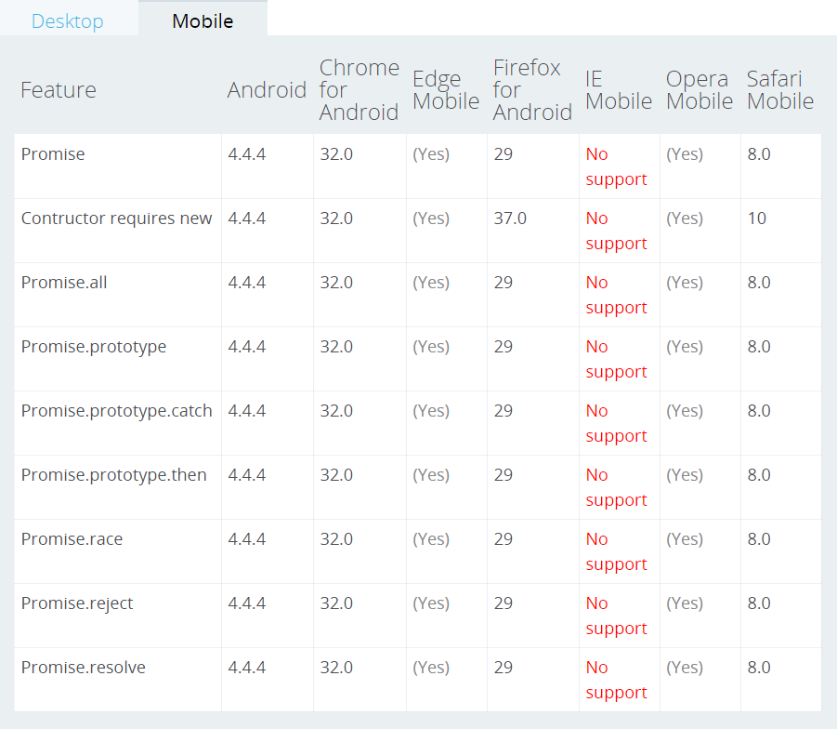
ECMAScript 6 & TypeScript
Browser Compatibility - Mobile
175
copyright 2016 Trainologic LTD

Slide 176
ECMAScript 6 & TypeScript
Enumerable Types
Modules
Types
Types
Iterators
Generators
Promises
Maps, Sets & Friends
Maps, Sets & Friends
176
copyright 2016 Trainologic LTD

Slide 177
ECMAScript 6 & TypeScript
Maps
The Map object is a simple key/value dictionary
Any value (both objects and primitive values) may be used as either a key or a value
Syntax: new Map([iterable])
Iterable is an optional other iterable object whose elements are key-value pairs
for…of looping on a map returns an [key, value] array (in insertion order) each iteration
Key equality is based on “same value” algorithm
NaN is considered same as Nan (although in JS they’re not)
All other values go by the === semantics
177
copyright 2016 Trainologic LTD

Slide 178
ECMAScript 6 & TypeScript
Maps vs. JS Objects
Similar in that both let us set/retrieve/delete/check values by keys
The main differences are:
An Object has a prototype, so we might have default keys
Object keys are Strings or Symbols, but can be any value for Map
Map’s size can be retrieved easily, difficult with an Object
Still, in many cases it is perfectly okay to continue using Objects
178
copyright 2016 Trainologic LTD

Slide 179
ECMAScript 6 & TypeScript
Map Properties & Methods
size – Returns the number of k/v pairs in the Map object
clear() – Removes all k/v pairs
delete(key) – Removes value, returns true/false if deleted/not-found
entries() – returns a new Iterator containing an array of [k,v] pairs per each iteration, in insertion order
keys() – Returns a new Iterator containing keys in insertion order
values() – Returns a new Iterator containing values in insertion order
forEach(cbFn) – calls cbFn for each k/v pair in insertion order
has(k) – Returns true if key exists in the Map
get(k) – Returns the value if key k exists, undefined otherwise
set(k, v) – Sets the value for the key, returns the Map (for chaining)
[@@iterator]() – Returns a new Iterator containing [k,v] array for each element in insertion order
179
copyright 2016 Trainologic LTD

Slide 180
ECMAScript 6 & TypeScript
Maps – Example: Simple
var myMap = new Map();
var keyString = "a string",
keyObj = {},
keyFunc = function () {};
// setting the values
myMap.set(keyString, "value associated with 'a string'");
myMap.set(keyObj, "value associated with keyObj");
myMap.set(keyFunc, "value associated with keyFunc");
myMap.size; // 3
// getting the values
myMap.get(keyString); // "value associated with 'a string'"
myMap.get(keyObj); // "value associated with keyObj"
myMap.get(keyFunc); // "value associated with keyFunc"
myMap.get("a string"); // "value associated with 'a string‘” because keyString === 'a string'
myMap.get({}); // undefined, because keyObj !== {}
myMap.get(function() {}) ; // undefined, because keyFunc !== function () {}
dsds
180
copyright 2016 Trainologic LTD

Slide 181
ECMAScript 6 & TypeScript
Maps – Example: Iterating
var myMap = new Map();
myMap.set(0, "zero");
myMap.set(1, "one");
for (var [key, value] of myMap) { // 0 = zero, 1 = one
console.log(key + " = " + value);
}
for (var key of myMap.keys()) { // 0, 1
console.log(key);
}
for (var value of myMap.values()) { // zero, one
console.log(value);
}
for (var [key, value] of myMap.entries()) { // 0 = zero, 1 = one
console.log(key + " = " + value);
}
myMap.forEach(function(value, key) { // 0 = zero, 1 = one
console.log(key + " = " + value);
});
dsds
181
copyright 2016 Trainologic LTD

Slide 182
ECMAScript 6 & TypeScript
TS – Transpiled Code
TS does not do any “magic” with Maps
It relies on ES6 Maps or a polyfill
var myMap = new Map();
myMap.set(0, "zero");
myMap.set(1, "one");
for (var [key, value] of myMap) {
console.log(key + " = " + value);
}
for (var key of myMap.keys()) {
console.log(key);
}
for (var value of myMap.values()) {
console.log(value);
}
for (var [key, value] of myMap.entries()) {
console.log(key + " = " + value);
}
myMap.forEach(function (value, key) {
console.log(key + " = " + value);
});
182
copyright 2016 Trainologic LTD

Slide 183
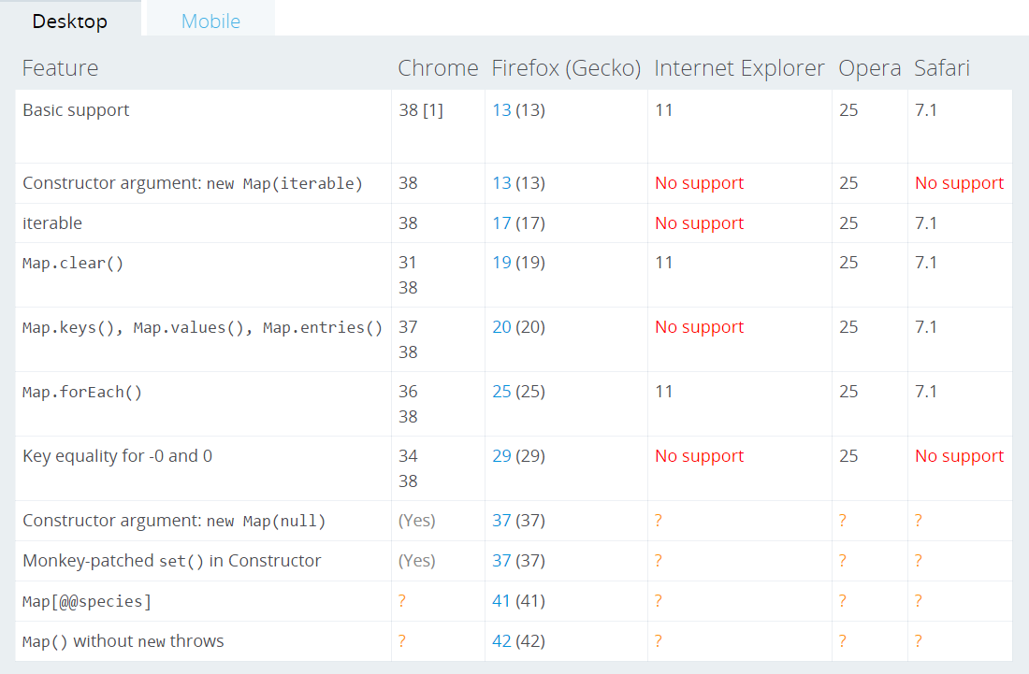
ECMAScript 6 & TypeScript
Browser Compatibility - Desktop
183
copyright 2016 Trainologic LTD

Slide 184
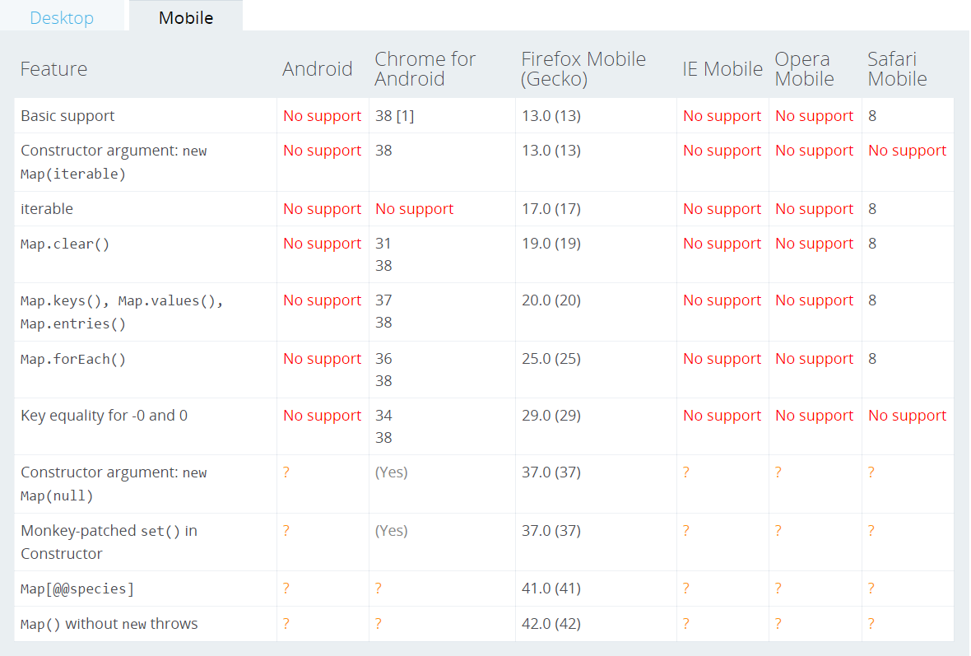
ECMAScript 6 & TypeScript
Browser Compatibility - Mobile
184
copyright 2016 Trainologic LTD

Slide 185
ECMAScript 6 & TypeScript
Sets
Set objects are collections of values, which we can iterate according to insertion order
Sets let us store unique values of any type, whether primitive values or object references
Syntax: new Set([iterable])
If an iterable object is passed, all of its elements will be added to the new Set
Value equality is similar to ===
var set = new Set();
set.add({a:1});
set.add({a:1});
console.log(set.size) // 2
console.log([...set.values()]); // Array [ Object, Object ]
185
copyright 2016 Trainologic LTD

Slide 186
ECMAScript 6 & TypeScript
TS – Transpiled Code
TS does not do any “magic” with Sets
It relies on ES6 Sets or a polyfill
TODO
186
copyright 2016 Trainologic LTD

Slide 187
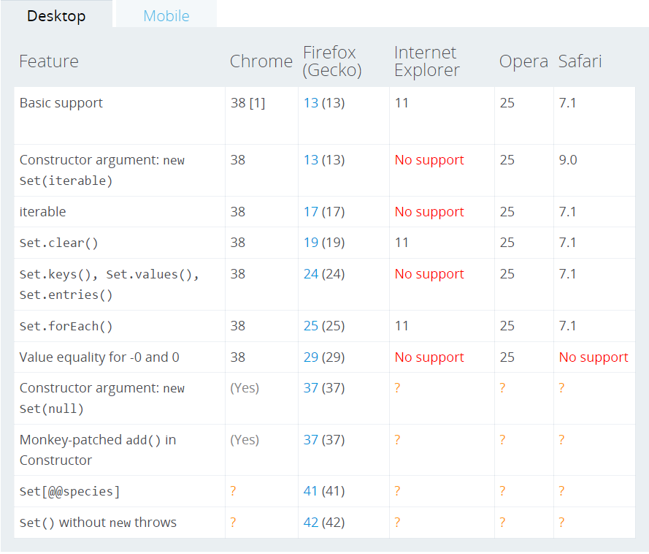
ECMAScript 6 & TypeScript
Browser Compatibility - Desktop
187
copyright 2016 Trainologic LTD

Slide 188
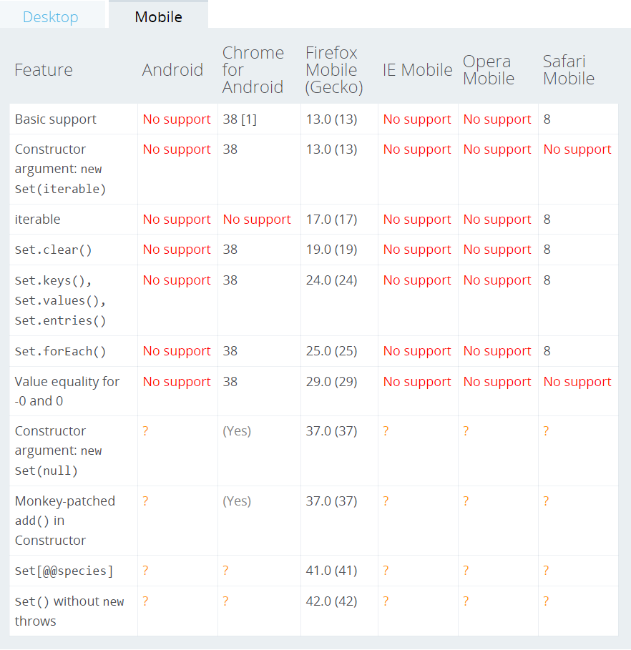
ECMAScript 6 & TypeScript
Browser Compatibility - Mobile
188
copyright 2016 Trainologic LTD

Slide 189
ECMAScript 6 & TypeScript
189
copyright 2016 Trainologic LTD

